Slide 1
Computer Organization and Architecture (AT70.01)
Comp. Sc. and Inf. Mgmt.
Asian Institute of Technology
Instructor: Dr. Sumanta Guha
Slide Sources: Patterson &
Hennessy COD book website
(copyright Morgan Kaufmann)
adapted and supplemented

Slide 2
COD Ch. 2
The Role of Performance

Slide 3
Performance
Performance is the key to understanding underlying motivation for the hardware and its organization
Measure, report, and summarize performance to enable users to
  make intelligent choices
  see through the marketing hype!
Why is some hardware better than others for different programs?
What factors of system performance are hardware related?
(e.g., do we need a new machine, or a new operating system?)
How does the machine's instruction set affect performance?

Slide 4

What do we measure?
Define performance….
Airplane Passengers Range (mi) Speed (mph)
Boeing 737-100 101 630 598
Boeing 747 470 4150 610
BAC/Sud Concorde 132 4000 1350
Douglas DC-8-50 146 8720 544
How much faster is the Concorde compared to the 747?
How much bigger is the Boeing 747 than the Douglas DC-8?
So which of these airplanes has the best performance?!

Slide 5
Computer Performance: TIME, TIME, TIME!!!
Response Time (elapsed time, latency):
  how long does it take for my job to run?
  how long does it take to execute (start to
  finish) my job?
  how long must I wait for the database query?
Throughput:
  how many jobs can the machine run at once?
  what is the average execution rate?
  how much work is getting done?
If we upgrade a machine with a new processor what do we increase?
If we add a new machine to the lab what do we increase?
Individual user
concerns…
Systems manager
concerns…
Notes:
Have them raise their hands when
answering questions

Slide 6
Execution Time
Elapsed Time
  counts everything (disk and memory accesses, waiting for I/O, running other programs, etc.) from start to finish
  a useful number, but often not good for comparison purposes
elapsed time = CPU time + wait time (I/O, other programs, etc.)
CPU time
  doesn't count waiting for I/O or time spent running other programs
  can be divided into user CPU time and system CPU time (OS calls)
CPU time = user CPU time + system CPU time
⇒ elapsed time = user CPU time + system CPU time + wait time
Our focus: user CPU time (CPU execution time or, simply, execution time)
  time spent executing the lines of code that are in our program

Slide 7
Definition of Performance
For some program running on machine X:
Performance_{X} = 1 / Execution time_{X}
X is n times faster than Y means:
Performance_{X} / Performance_{Y} = n

Slide 8
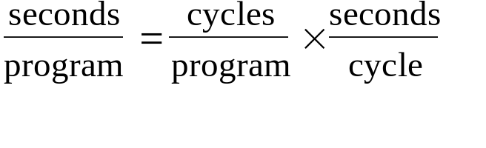
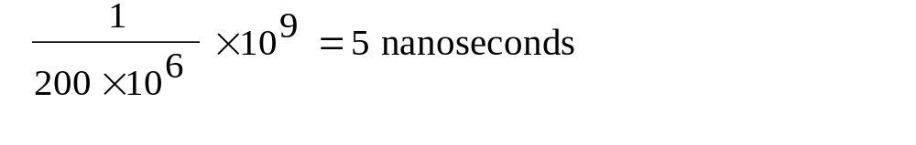
Clock Cycles
Instead of reporting execution time in seconds, we often use cycles. In modern computers hardware events progress cycle by cycle: in other words, each event, e.g., multiplication, addition, etc., is a sequence of cycles
Clock ticks indicate start and end of cycles:
cycle time = time between ticks = seconds per cycle
clock rate (frequency) = cycles per second (1 Hz. = 1 cycle/sec, 1 MHz. = 10⁶ cycles/sec)
Example: A 200 Mhz. clock has a cycle time
cycle
time
tick
tick

Slide 9
Performance Equation I
equivalently
CPU execution time CPU clock cycles Clock cycle time
for a program for a program
×
=
So, to improve performance one can either:
  reduce the number of cycles for a program, or
  reduce the clock cycle time, or, equivalently,
  increase the clock rate

Slide 10
How many cycles are required for a program?
Could assume that # of cycles = # of instructions
1st instruction
3rd instruction
2nd instruction
4th
5th
6th
...
time
This assumption is incorrect! Because:
  Different instructions take different amounts of time (cycles)
  Why…?

Slide 11
How many cycles are required for a program?
time
Multiplication takes more time than addition
Floating point operations take longer than integer ones
Accessing memory takes more time than accessing registers
Important point: changing the cycle time often changes the number of cycles required for various instructions because it means changing the hardware design. More later…

Slide 12
Example
Our favorite program runs in 10 seconds on computer A, which has a 400Mhz. clock.
We are trying to help a computer designer build a new machine B, that will run this program in 6 seconds. The designer can use new (or perhaps more expensive) technology to substantially increase the clock rate, but has informed us that this increase will affect the rest of the CPU design, causing machine B to require 1.2 times as many clock cycles as machine A for the same program.
What clock rate should we tell the designer to target?

Slide 13
Terminology
A given program will require:
  some number of instructions (machine instructions)
  some number of cycles
  some number of seconds
We have a vocabulary that relates these quantities:
  cycle time (seconds per cycle)
  clock rate (cycles per second)
  (average) CPI (cycles per instruction)
    a floating point intensive application might have a higher average CPI
  MIPS (millions of instructions per second)
    this would be higher for a program using simple instructions

Slide 14
Performance Measure
Performance is determined by execution time
Do any of these other variables equal performance?
  # of cycles to execute program?
  # of instructions in program?
  # of cycles per second?
  average # of cycles per instruction?
  average # of instructions per second?
Common pitfall : thinking one of the variables is indicative of performance when it really isn’t

Slide 15
Performance Equation II
×
×
CPU execution time Instruction count average CPI Clock cycle time
for a program for a program
Derive the above equation from Performance Equation I
=

Slide 16
CPI Example I
Suppose we have two implementations of the same instruction set architecture (ISA). For some program:
  machine A has a clock cycle time of 10 ns. and a CPI of 2.0
  machine B has a clock cycle time of 20 ns. and a CPI of 1.2
Which machine is faster for this program, and by how much?
If two machines have the same ISA, which of our quantities (e.g., clock rate, CPI, execution time, # of instructions, MIPS) will always be identical?

Slide 17
CPI Example II
A compiler designer is trying to decide between two code sequences for a particular machine.
Based on the hardware implementation, there are three different classes of instructions: Class A, Class B, and Class C, and they require 1, 2 and 3 cycles (respectively).
The first code sequence has 5 instructions:
2 of A, 1 of B, and 2 of C
The second sequence has 6 instructions:
4 of A, 1 of B, and 1 of C.
Which sequence will be faster? How much? What is the CPI for each sequence?

Slide 18
MIPS Example
Two different compilers are being tested for a 500 MHz. machine with three different classes of instructions: Class A, Class B, and Class C, which require 1, 2 and 3 cycles (respectively). Both compilers are used to produce code for a large piece of software.
Compiler 1 generates code with 5 billion Class A instructions, 1 billion Class B instructions, and 1 billion Class C instructions.
Compiler 2 generates code with 10 billion Class A instructions, 1 billion Class B instructions, and 1 billion Class C instructions.
Which sequence will be faster according to MIPS?
Which sequence will be faster according to execution time?

Slide 19
Benchmarks
Performance best determined by running a real application
  use programs typical of expected workload
  or, typical of expected class of applications
  e.g., compilers/editors, scientific applications, graphics, etc.
Small benchmarks
  nice for architects and designers
  easy to standardize
  can be abused!
Benchmark suites
  Perfect Club: set of application codes
  Livermore Loops: 24 loop kernels
  Linpack: linear algebra package
  SPEC: mix of code from industry organization

Slide 20
SPEC (System Performance Evaluation Corporation)
Sponsored by industry but independent and self-managed – trusted by code developers and machine vendors
Clear guides for testing, see www.spec.org
Regular updates (benchmarks are dropped and new ones added periodically according to relevance)
Specialized benchmarks for particular classes of applications
Can still be abused…, by selective optimization!

Slide 21
SPEC History
First Round: SPEC CPU89
  10 programs yielding a single number
Second Round: SPEC CPU92
  SPEC CINT92 (6 integer programs) and SPEC CFP92 (14 floating point programs)
  compiler flags can be set differently for different programs
Third Round: SPEC CPU95
  new set of programs: SPEC CINT95 (8 integer programs) and SPEC CFP95 (10 floating point)
  single flag setting for all programs
Fourth Round: SPEC CPU2000
  new set of programs: SPEC CINT2000 (12 integer programs) and SPEC CFP2000 (14 floating point)
  single flag setting for all programs
  programs in C, C++, Fortran 77, and Fortran 90

Slide 22
CINT2000 (Integer component of SPEC CPU2000)
Program Language What It Is
164.gzip C Compression
175.vpr C FPGA Circuit Placement and Routing
176.gcc C C Programming Language Compiler
181.mcf C Combinatorial Optimization
186.crafty C Game Playing: Chess
197.parser C Word Processing
252.eon C++ Computer Visualization
253.perlbmk C PERL Programming Language
254.gap C Group Theory, Interpreter
255.vortex C Object-oriented Database
256.bzip2 C Compression
300.twolf C Place and Route Simulator

Slide 23
CFP2000 (Floating point component of SPEC CPU2000)
Program Language What It Is
168.wupwise Fortran 77 Physics / Quantum Chromodynamics
171.swim Fortran 77 Shallow Water Modeling
172.mgrid Fortran 77 Multi-grid Solver: 3D Potential Field
173.applu Fortran 77 Parabolic / Elliptic Differential Equations
177.mesa C 3-D Graphics Library
178.galgel Fortran 90 Computational Fluid Dynamics
179.art C Image Recognition / Neural Networks
183.equake C Seismic Wave Propagation Simulation
187.facerec Fortran 90 Image Processing: Face Recognition
188.ammp C Computational Chemistry
189.lucas Fortran 90 Number Theory / Primality Testing
191.fma3d Fortran 90 Finite-element Crash Simulation
200.sixtrack Fortran 77 High Energy Physics Accelerator Design
301.apsi Fortran 77 Meteorology: Pollutant Distribution

Slide 24
SPEC CPU2000 reporting
Refer SPEC website www.spec.org for documentation
Single number result – geometric mean of normalized ratios for each code in the suite
Report precise description of machine
Report compiler flag setting

Slide 25
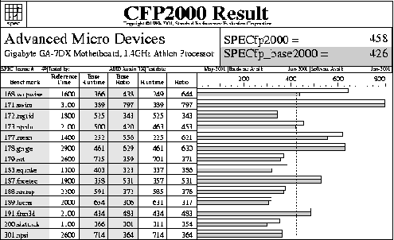

Slide 26
Specialized SPEC Benchmarks
I/O
Network
Graphics
Java
Web server
Transaction processing (databases)

Slide 27
Amdahl's Law
Execution Time After Improvement =
Execution Time Unaffected + ( Execution Time Affected / Rate of Improvement )
Example:
  Suppose a program runs in 100 seconds on a machine, with
  multiply responsible for 80 seconds of this time.
  How much do we have to improve the speed of multiplication if we want the program to run 4 times faster?
  How about making it 5 times faster?
Design Principle: Make the common case fast
Improved part of code

Slide 28
Examples
Suppose we enhance a machine making all floating-point instructions run five times faster. The execution time of some benchmark before the floating-point enhancement is 10 seconds.
  What will the speedup be if half of the 10 seconds is spent executing floating-point instructions?
We are looking for a benchmark to show off the new floating-point unit described above, and want the overall benchmark to show a speedup of 3. One benchmark we are considering runs for 100 seconds with the old floating-point hardware.
  How much of the execution time would floating-point instructions have to account for in this program in order to yield our desired speedup on this benchmark?

Slide 29
Summary
Performance is specific to a particular program
  total execution time is a consistent summary of performance
For a given architecture performance increases come from:
  increases in clock rate (without adverse CPI affects)
  improvements in processor organization that lower CPI
  compiler enhancements that lower CPI and/or instruction count
Pitfall: expecting improvement in one aspect of a machine’s performance to affect the total performance
You should not always believe everything you read! Read carefully! See newspaper articles, e.g., Exercise 2.37!!

